Slide 1
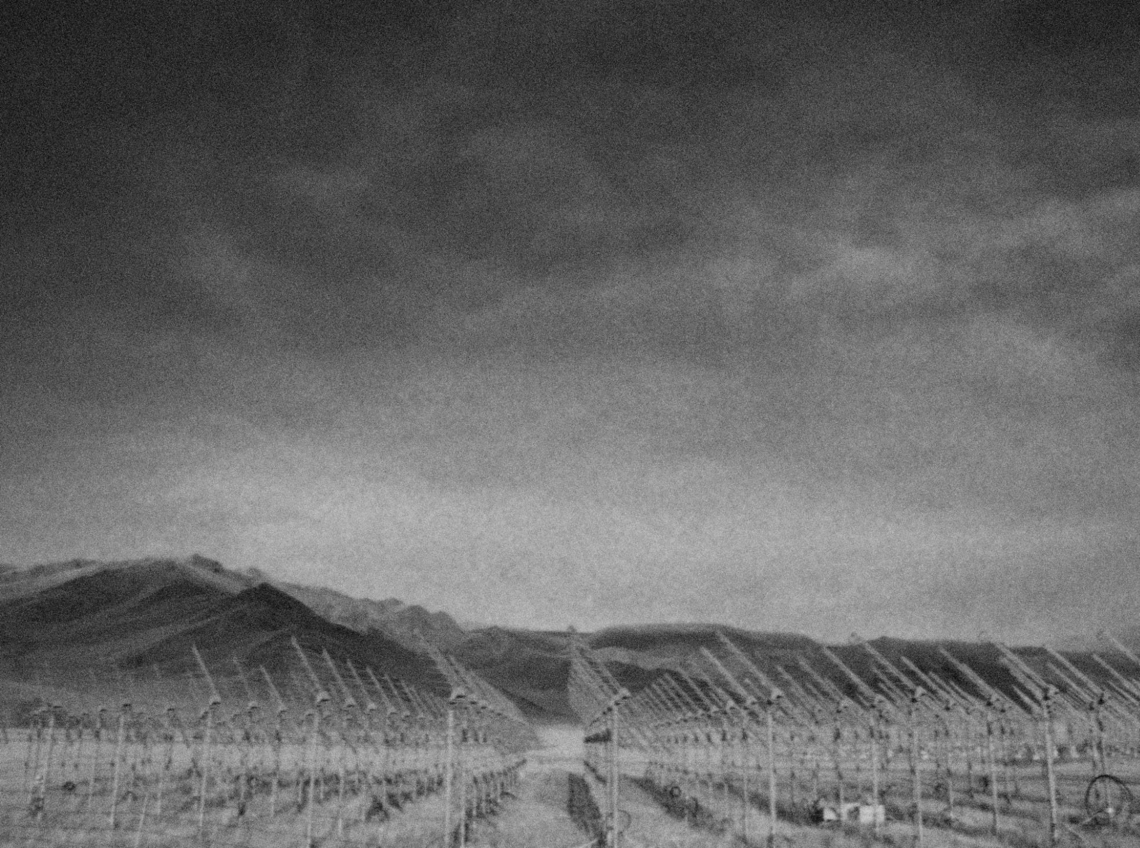
Autonomous detection of air showers with the TREND radio-array
Olivier Martineau-Huynh
KIAA workshop, BeiDa
August 18, 2017
NAOC: XiangPing Wu, Junhua Gu, Sandra Le Coz, Jianli Zhang, Thomas Saugrin, Meng Zhao
IHEP: HongBo Hu, Quanbu Gou, Zhang Yi
IN2P3: OMH, Valentin Niess, Didier Charrier

Slide 2
Motivations for the TREND experiment
(as of 2008)
Mid 2000’s: re-birth of EAS radio detection (CODALEMA & LOPES)
  All primary informations (direction of origin, E, nature) accessible in principle through radio info.
  Large duty cycle & access to shower development information.
  Fast electronics allow proper handling of antenna signals
  Cheap, robust & handable detectors ➔ well suited to large arrays.
Challenge:
  Many radio sources in the signal frequency range (10s-~100 MHz) ➔ very bad signal/noise ratio making self triggering & EAS identification challenging.
  Most arrays (developped atop existing setups) rely on external triggering.
Need for investigatation of autonomous radiodetection of air showers.

Slide 3
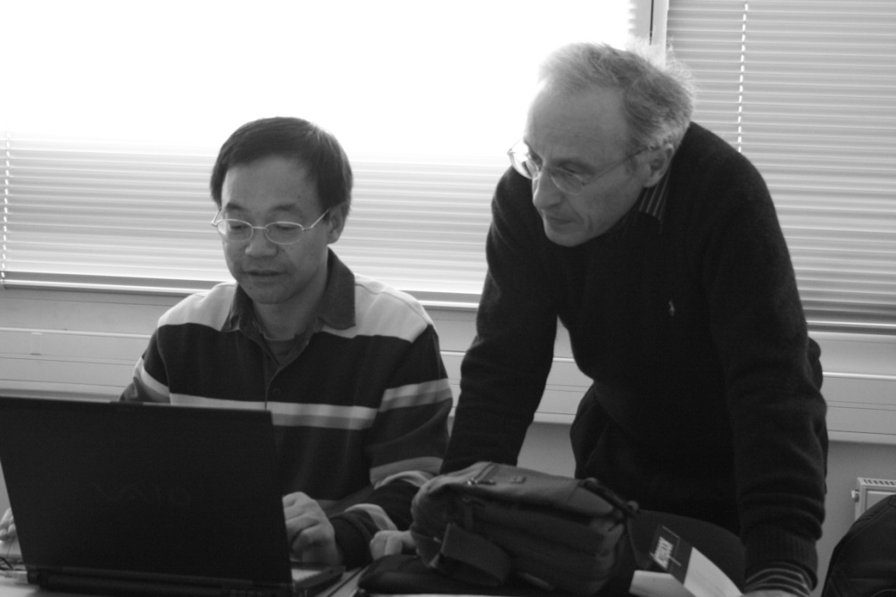
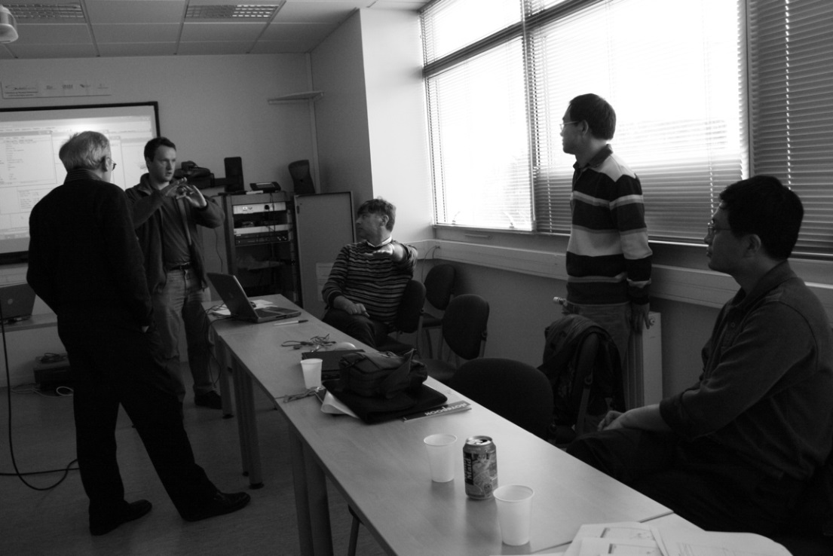
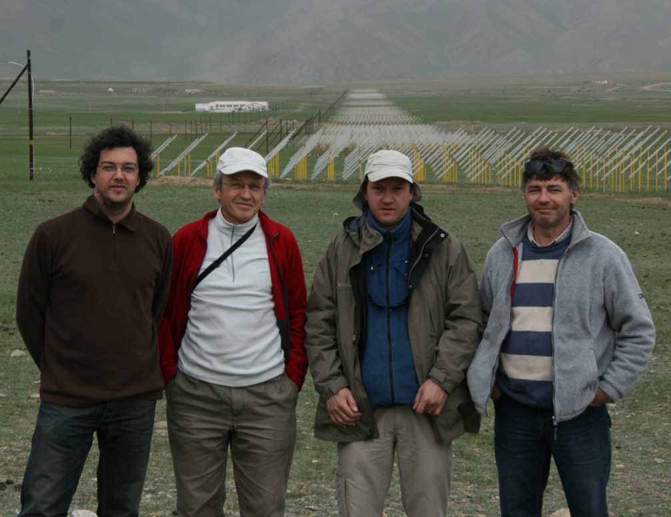
TREND genesis
(2007-2008)
Meeting with Wu XiangPing & Hu HongBo + IN2P3 radio-experts (2007)
Survey of 21CMA site (Summer 2008)
OMH @ NAOC/IHEP (09/2008 – 08/2013)

Slide 4
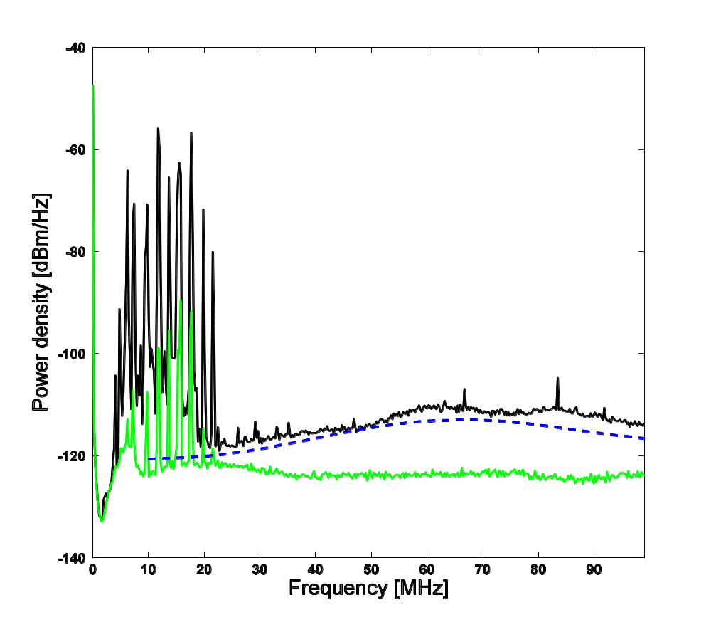
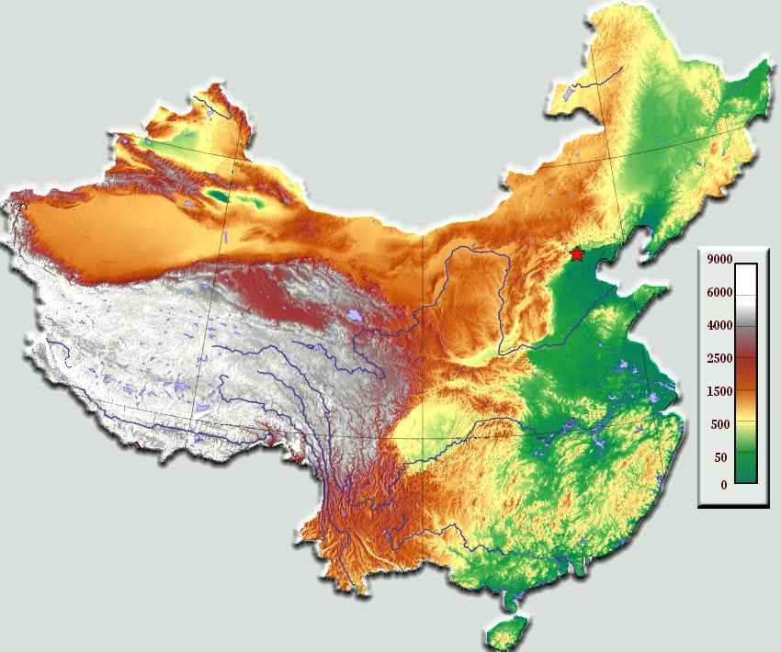
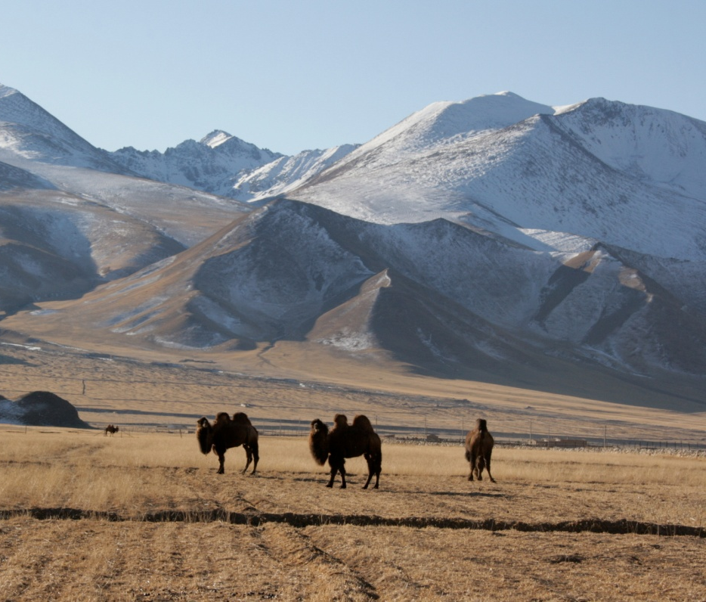
The TREND site
Short waves
Simulated
galactic bckgd
Measured bckgd noise
Urumqi
Ulastai
Beijing
TREND
@ Ulastai
Ulastai, Tianshan mountains, XinJiang autonomous province (2650m asl)
Background noise very close to optimal (Galactic emission)

Slide 5

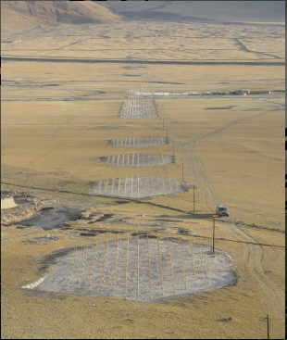
The 21cm array
North
Radiointerferometer for the study of the Epoch of Reionization (Wu XiangPing, NAOC) completed in 2007.
Contact through FCPPL network
(Roos & Tao)
4 km
West
East
DAQ
3 km
South

Slide 6
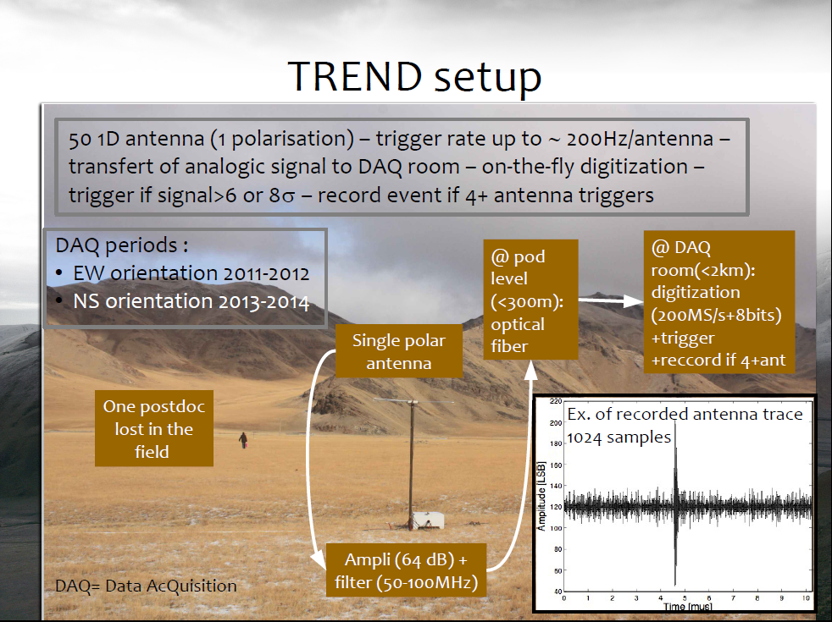

Slide 7
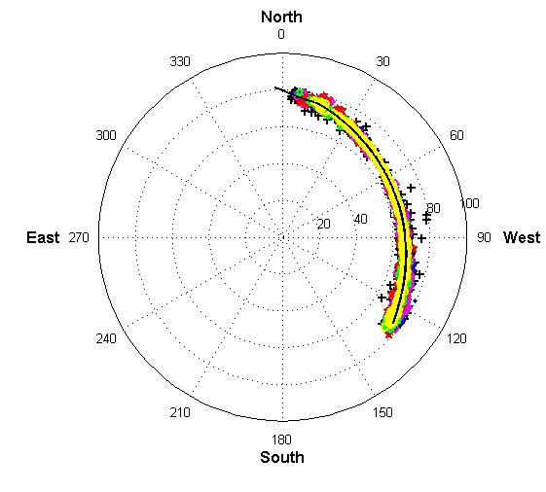
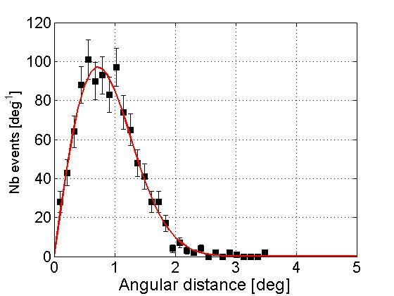
RADIO PERFORMANCES:
DIRECTION RECONSTRUCTION
Plane track reconstruction :
- 3037 events in 4 minutes
Θ > 60°
Max multiplicity: 40
Point source recons
mult ≥ 22 antennas
σ = 0.7°
Total angular resolution <1.5° on the track
(and improves with smaller zenithal angle)

Slide 8
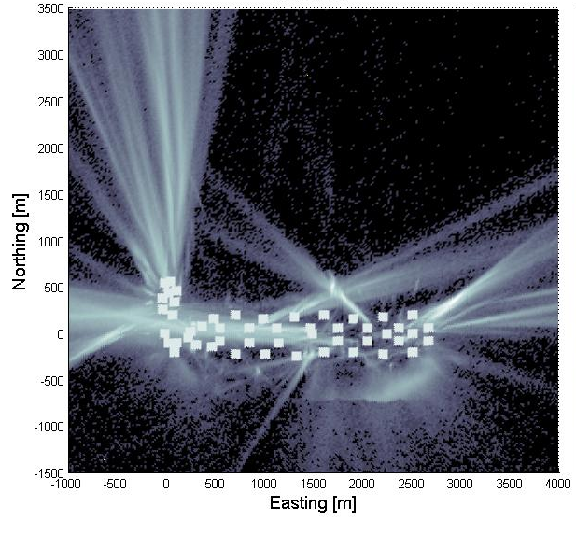
Radio background
TREND-50 antennas
radio array:
2011-2012 data
(E-W polarization)
316 DAQ days analyzed
8 10⁹ triggers recorded ⬄ 8TBy
7 10⁸ coincidences
~25Hz event rate
over whole array (physical origin)
Expected EAS trigger rate:
~40/day
TREND antenna
Reconstructed source position
Background rejection is a key issue for EAS radio-detection.
Background sources: HV lines, radio emiters, train, cars, planes, thunderstorms…

Slide 9
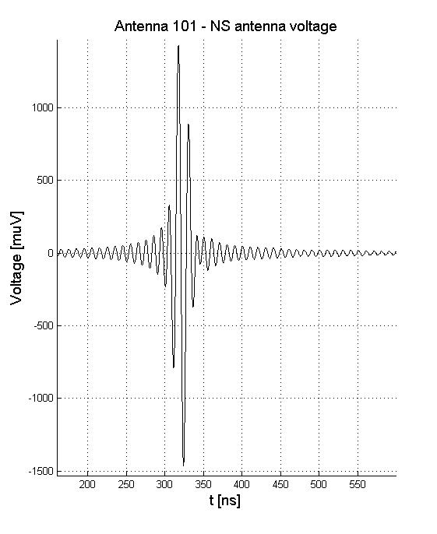
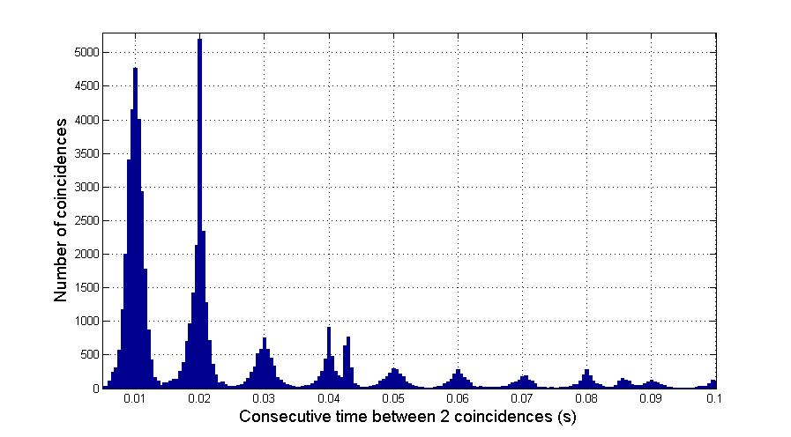
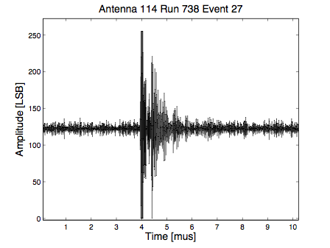
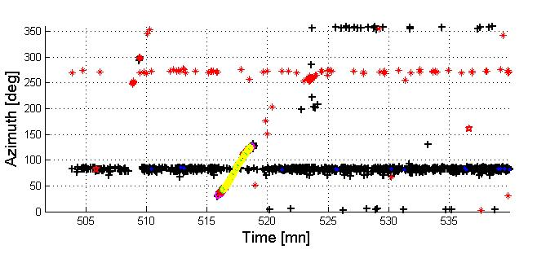
Discriminating parameters
10 ms ⬄ 50Hz
power line
200ns
Simulated EAS trace
2000ns
Data trace

Slide 10
Cut efficiency: from 7.3 10⁸ coincidences to 574 EAS candidates
Cut | % survival | N_{coincs} final
« 50Hz » cut | 8% | 6.3 10⁷
Pulse duration | 46% | 2.9 10⁷
Multiplicity > 4 | 51% | 1.4 10⁷
Valid reconstruction | 67% | 1.0 10⁷
Radius > 3000m | 35% | 3.4 10⁶
Θ < 80° | 30% | 1.0 10⁶
Trigger pattern/ Extension | 32% | 3.3 10 ⁵
Neighbourgs (direction) | 0.3% | 1440
Neighbourgs (time) | 40% | 574
No cut is related to wave (absolute) arrival direction.

Slide 11
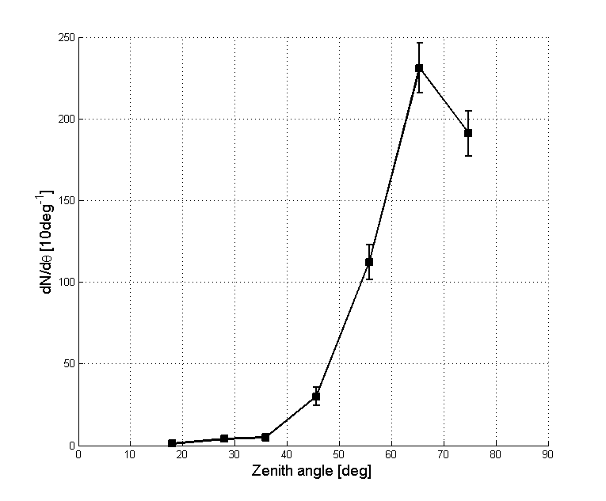
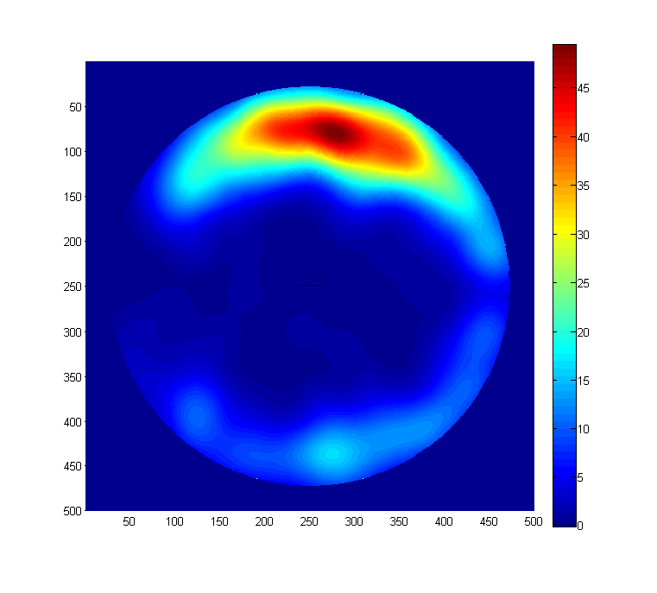
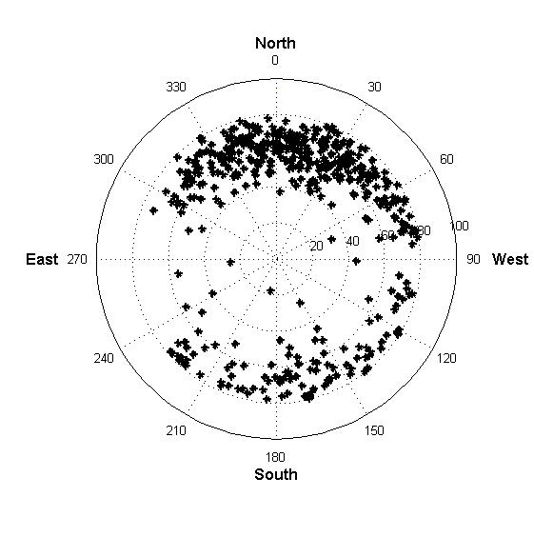
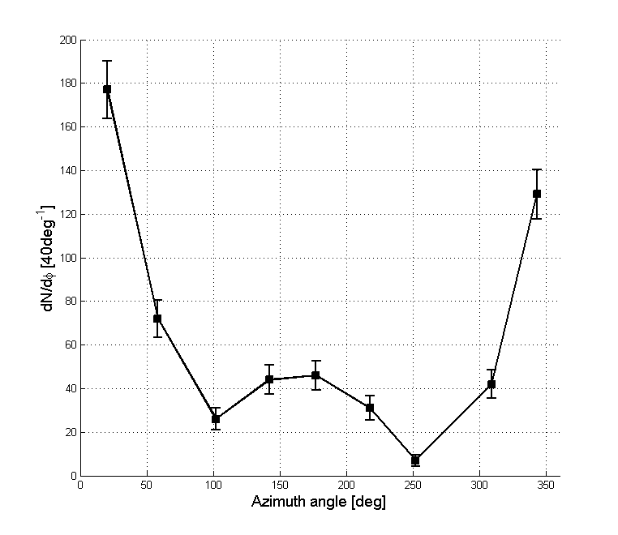
TREND EAS candidates
90°
60°
30°
Excess to North
(α~90°)
Deficit to
East & West
(α~0°)
2011-2012 data - 316 DAQ days
EW polar
574 EAS candidates

Slide 12
TREND real-time event simulation
Primary
(A, E, θ,ϕ, x_{core})
p or Fe, 11 fixed energies in [5 10¹⁶, 5 10¹⁸eV], random sky distribution & random core position (<1km of detector)
Air shower + radio simulation
ZHAireS or Conex+EVA. ~8 10⁶ simulated events so far (and running)
E(t) [V/m] @
antenna positions
Antenna response simulation
NEC2 code
Voltage(t) [V] @
antenna foot
Propagation through DAQ chain at fixed random time t*
Signal @ ADC
Calibration: g(t*)
Voltage(t) [LSB]
@ DAQ
Retrieve noise & computer status at t=t*. Evaluate trigger and select event if 4+ antennas are OK.
signal
@ disk
Inserted in experimental data set
Offline (blind) analysis
Fully processed (realistic) simulated data set (completed on 80 days subset so far).

Slide 13
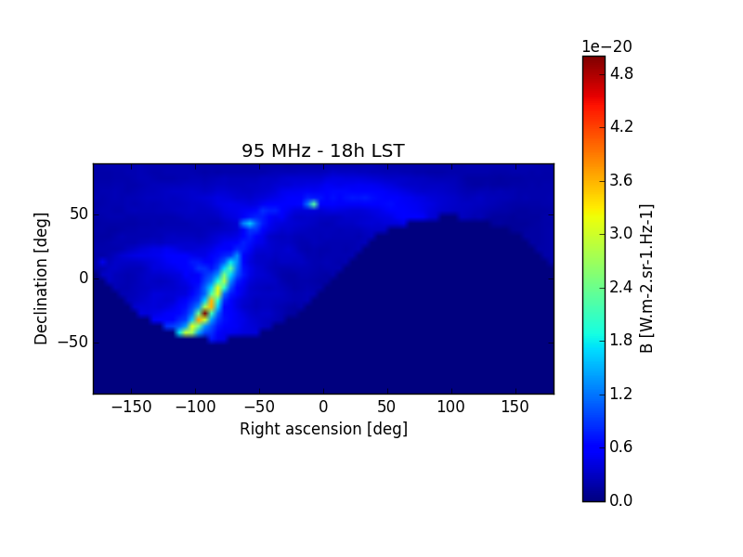
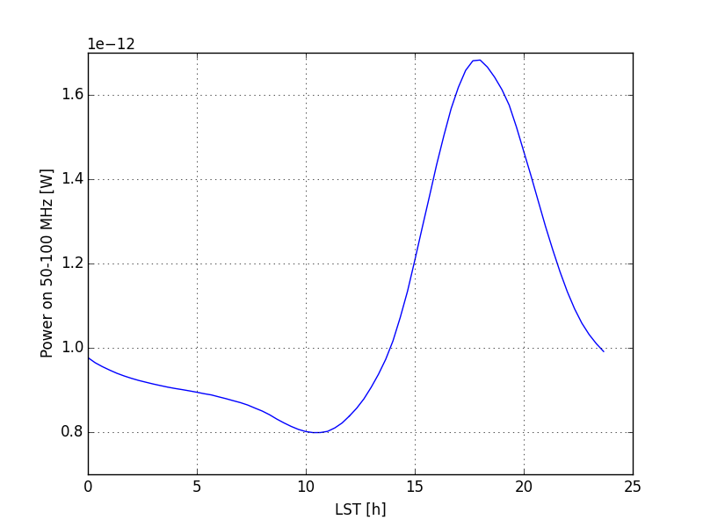
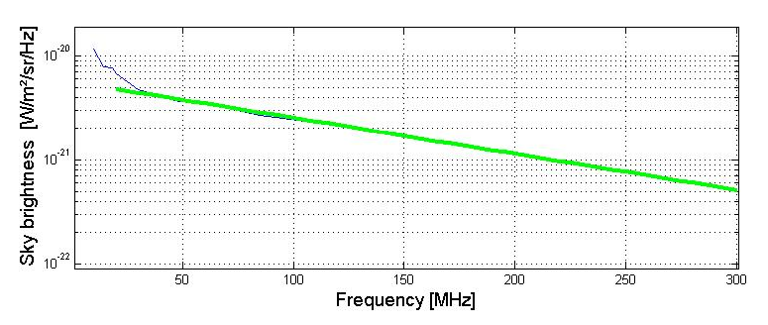
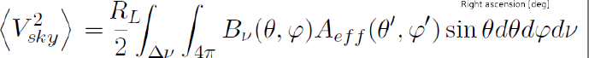
TREND calibration
[S. Le Coz, V. Niess]
In TREND frequency range, sky emission highly dominated by Galactic plane radiation.
Very well known ➔ provides a stable & periodic source for calibration & monitoring.
95MHz sky in TREND antenna FoV @ 18h LST
TREND antenna
Galactic simulation
EW polarisation

Slide 14
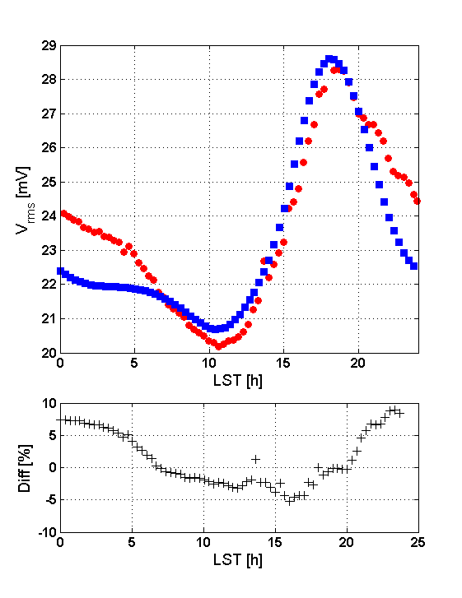
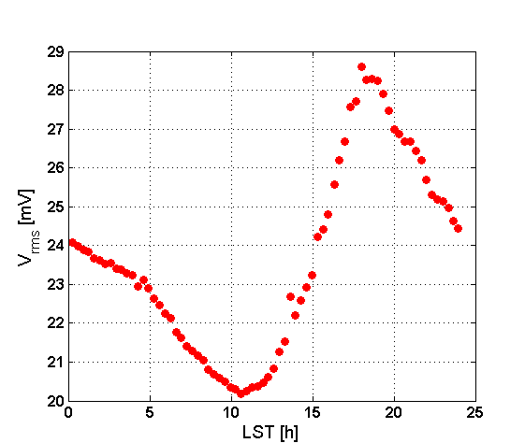
TREND calibration
TREND antenna
Galactic simulation
@ antenna foot
TREND monitoring data
Galactic sim signal x g
x gain
TREND monitoring
data @ DAQ
Antenna 105
March 19-20, 2012

Slide 15
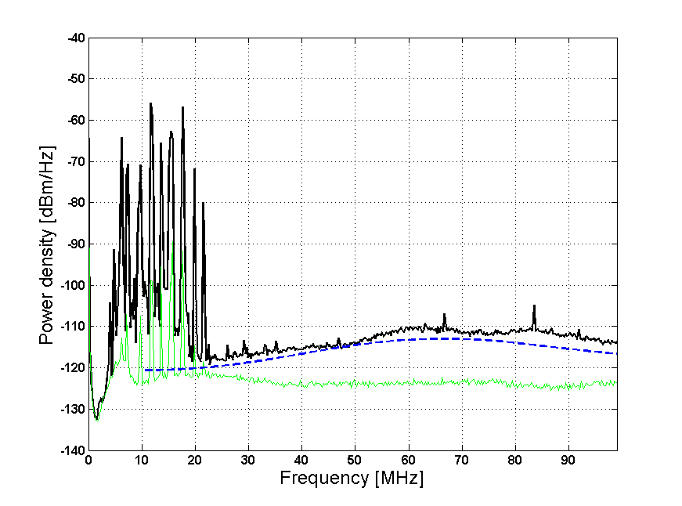
Gain correction
Dedicated measurements show that V_{Ant} is systematically 1-2.5dB higher than model.
Likely causes: environment noise + FE electronic chain noise.
g=V_{ADC}/V_{ant} ➔ 10-30% gain overestimate in our treatment
➔ ad hoc correction factor
f = 0.85±0.1 applied to g(t)
Modeled bckgd
Measured bckgd

Slide 16
Cut efficiency evaluated from 1862 simulated events inserted in data stream
Cut | % survival | N_{coincs} final | % survival [simu] | N_{coins} [simu] (not E weighted)
« 50Hz » cut | 8% | 6.3 10⁷ | 82% | 1526
Pulse duration | 46% | 2.9 10⁷ | 86% | 1312
Multiplicity > 4 | 51% | 1.4 10⁷ | 80% | 1050
Valid reconstruction | 67% | 1.0 10⁷ | 99% | 1040
Radius > 3000m | 35% | 3.4 10⁶ | 95% | 988
Θ < 80° | 30% | 1.0 10⁶ | 98% | 968
Trigger pattern/ Extension | 32% | 3.3 10 ⁵ | 88% | 855
Neighbourgs (direction) | 0.3% | 1440 | 85% | 725
Neighbourgs (time) | 40% | 574 | 92% | 668
Simulated EAS selection cuts survival rate: 37% (46% if multiplicity cut excluded)

Slide 17
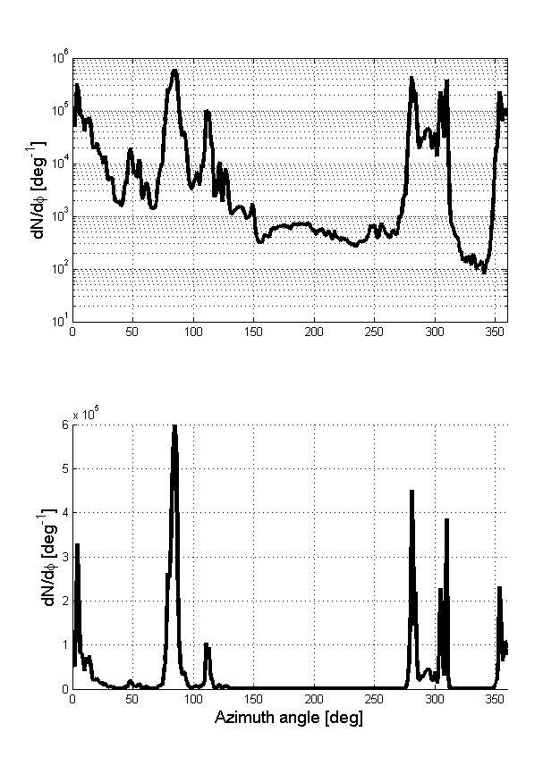
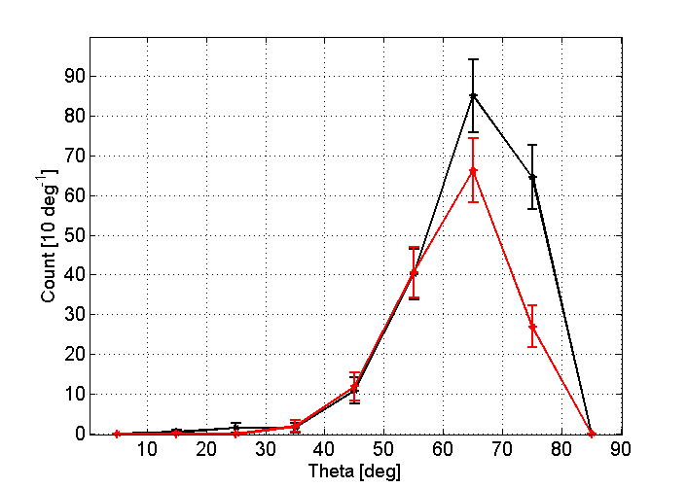
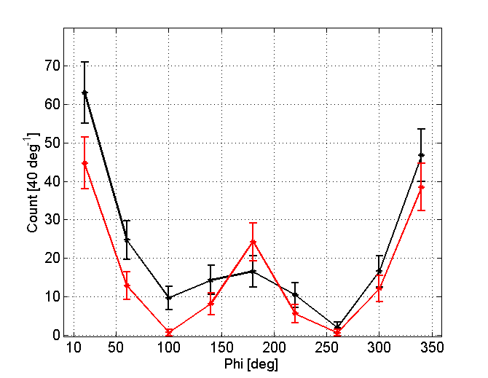
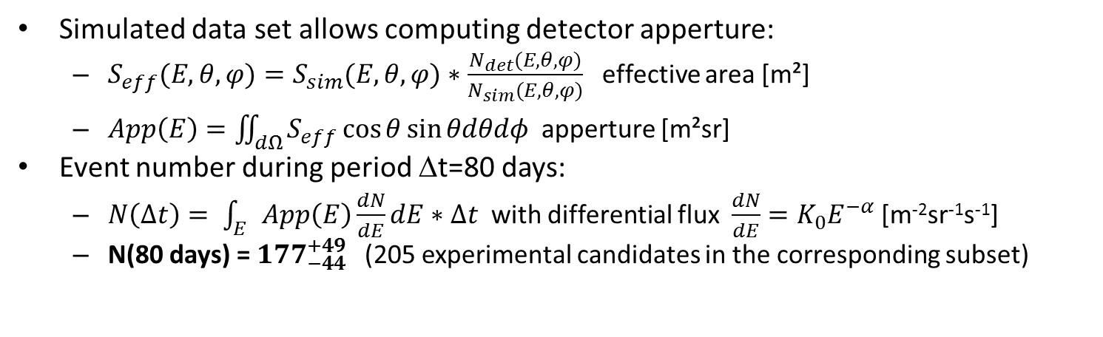
Results
Simulated data set allows computing detector apperture:
  $S_{eff}(E,θ,φ)=S_{sim}(E,θ,φ)∗\frac{N_{det}(E,θ,φ)}{N_{sim}(E,θ,φ)}$ effective area [m²]
  $App\left(E\right)=\iint_{dΩ}{S_{eff}\cos{θ}sin{θdθdφ} }$apperture [m²sr]
Event number during period Δt=80 days:
  $N\left(Δt\right)= \int_{E}{App\left(E\right)\frac{dN}{dE}dE}∗Δt$ with differential flux $\frac{dN}{dE}=K_{0}E^{−α}$ [m⁻²sr⁻¹s⁻¹]
  N(80 days) = ${177}_{−44}^{+49}$(205 experimental candidates in the corresponding subset)
Azimuth distribution
All data
Zenith distribution
Azimuth distribution
Data (EAS candidates)
Simulated TREND events
[f = 0.8]
S. Le Coz
(NAOC)
S. Le Coz
(NAOC)

Slide 18
TREND has performed autonomous detection & identification of air showers over ultra-dominant background with limited background contamination (<30%)

Slide 19
Simulated events
Random (θ,ϕ)
Random core position
Random t
DAQ time: 80 days (02-06/2012)
Preliminary results
To be confirmed with full TREND dataset (317 days)
5+ antenna triggers
«ideal» detector: Antenna+DAQ live time = 100%
Expected
nb of events:
2192
Instantaneous antenna + DAQ status
ε_{det}~20%
«ideal» selection: 100% EAS pass cuts
Expected
nb of events:
381
ε_{tot}~8%
Offline EAS selection
Expected
nb of events:
177
ε_{sel}~50%
TREND EAS selection

Slide 20
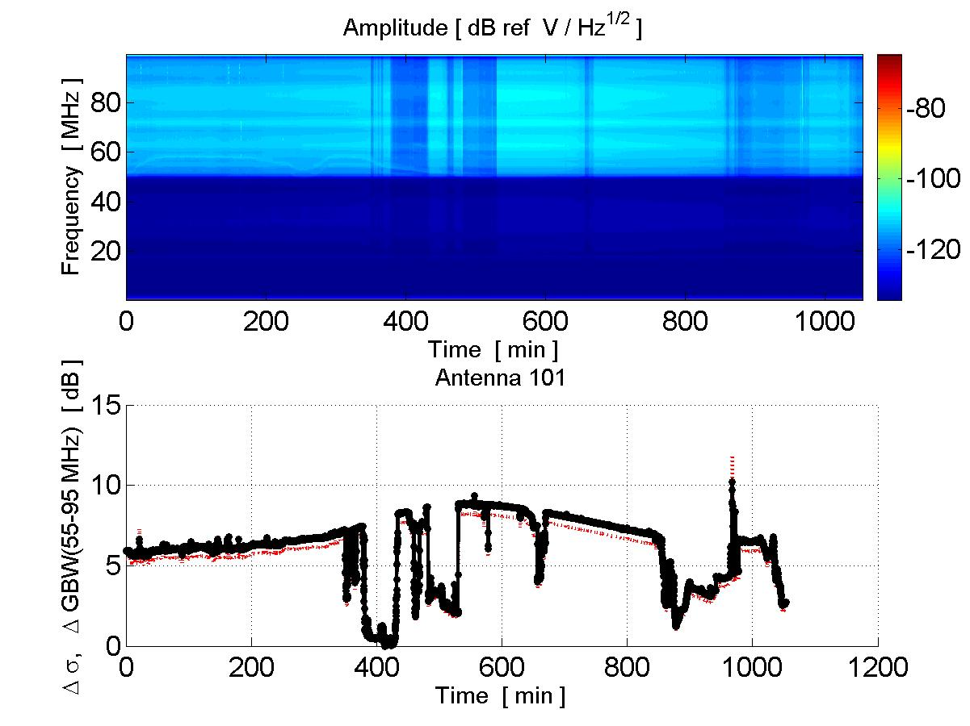
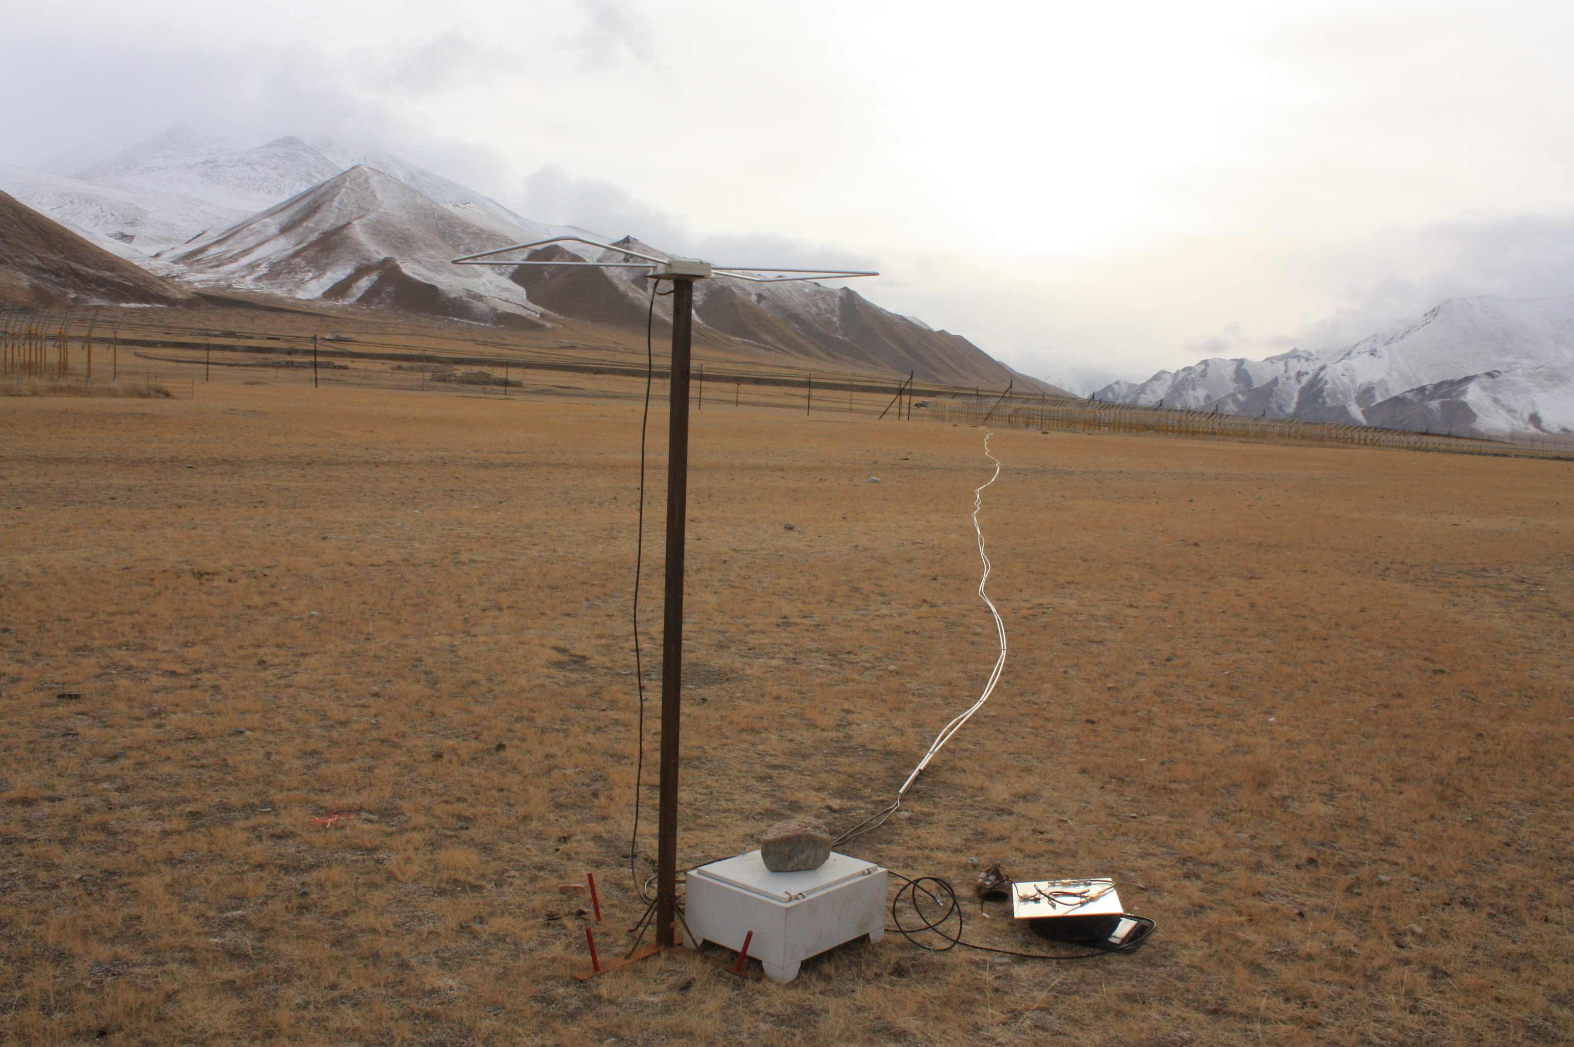
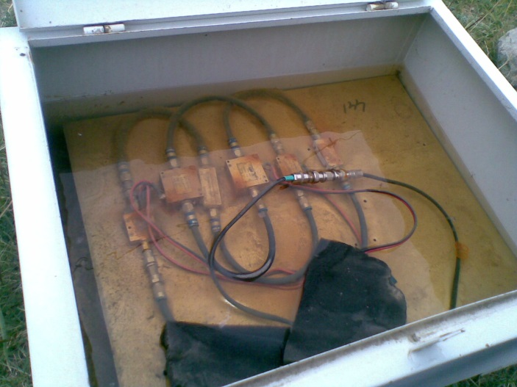
TREND issues
«You get what you pay for»: system reliability questionnable
  Sudden drops in gain
  Aging (antennas, amplifiers, optical system, computers…)
50-100MHz noise level (dB)

Slide 21
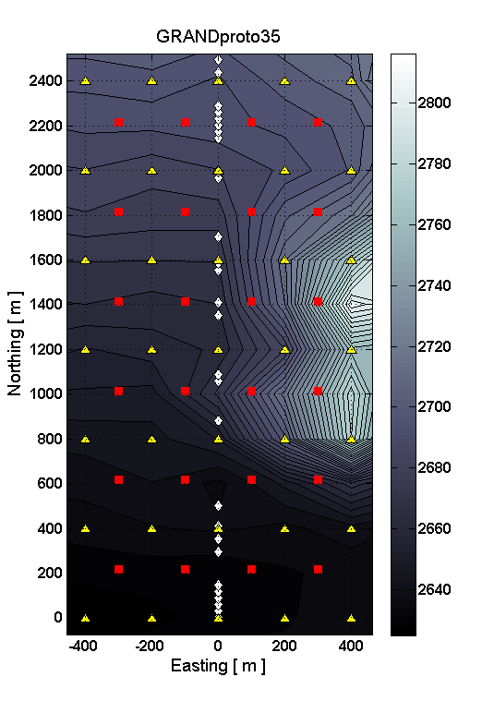
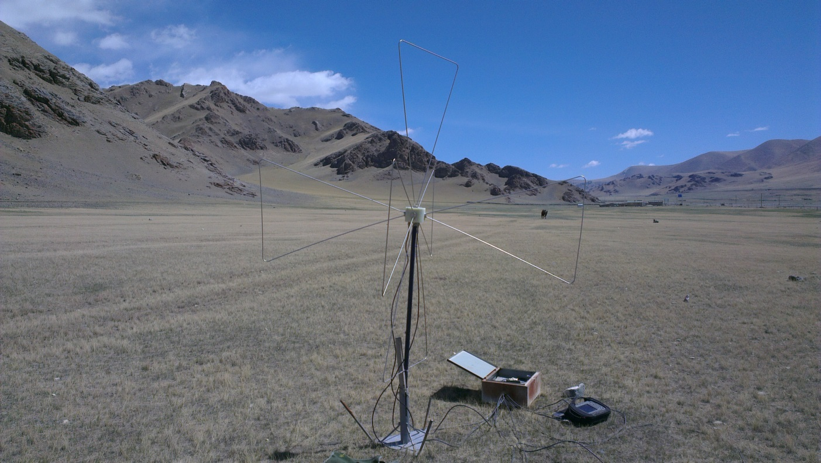
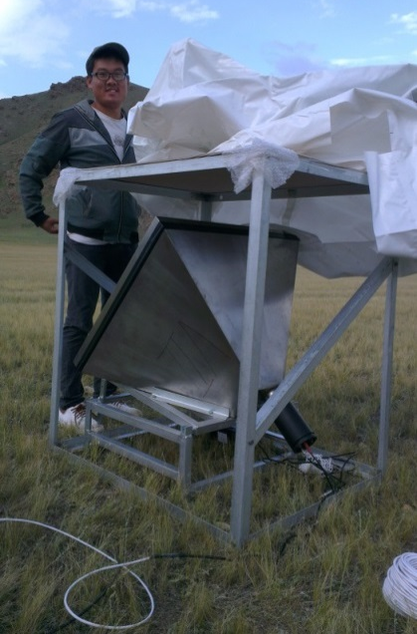
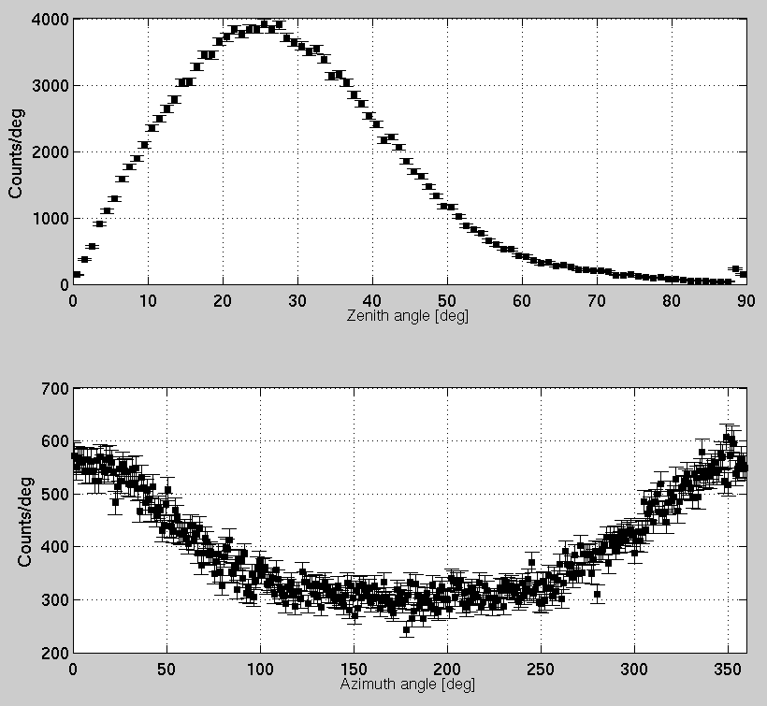
Next step: GRANDproto35
Scintillators
Antennas
a GRANDproto35 antenna at test
GRANDproto35: dedicated setup of 35 antennas deployed on the TREND site (NAOC) + 24 scintillators for offline EAS nature check (IHEP).
Goal: optimized detection efficiency + air shower purity.
  Polarization measurement (3 arms antenna) brings additionnal tools for background rejection
  Dedicated electronics & DAQ (developped at LPNHE) should allow ~100% live time.
Direct measurement of these 2 parameters (scintillator ground array).
Deployment just started, data taking to start early 2018
Zenith distrib
Azim distrib
a GRANDproto35 scintillator

Slide 22
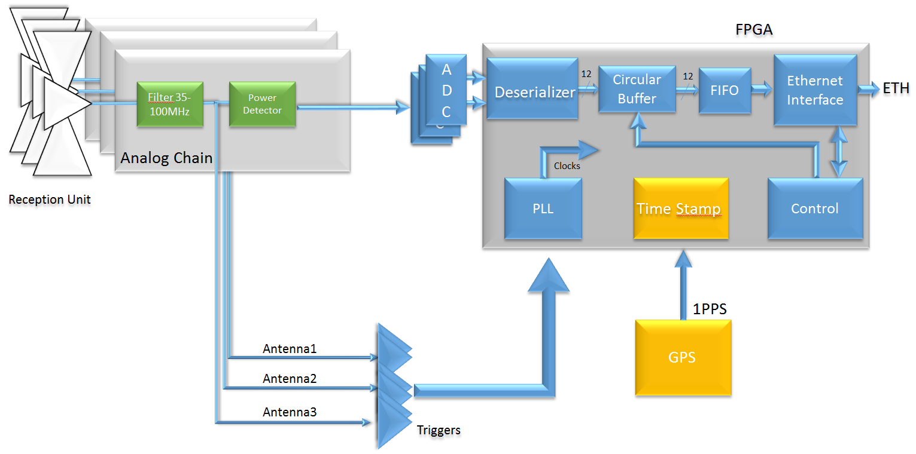
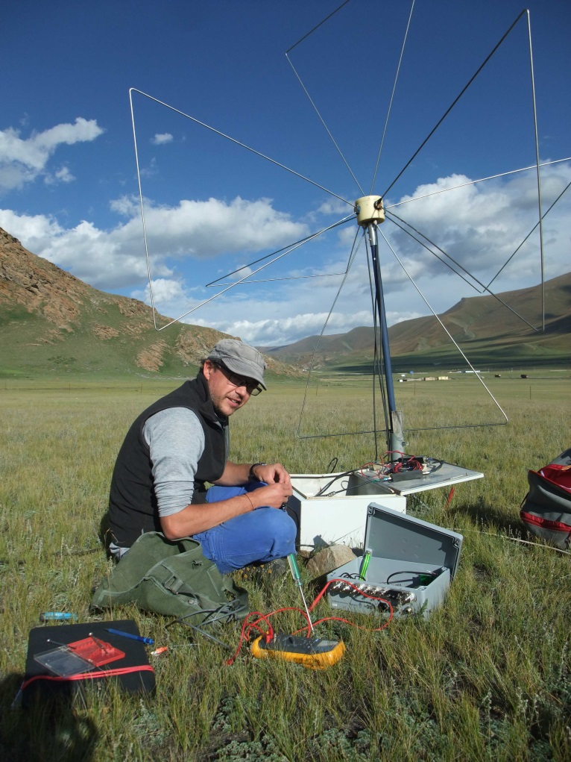
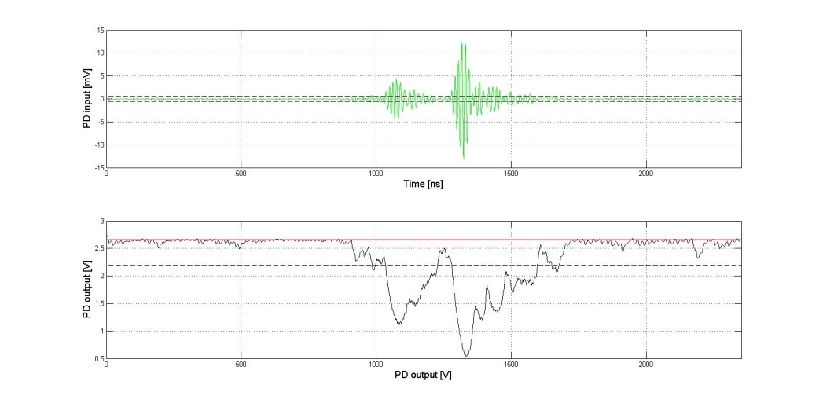
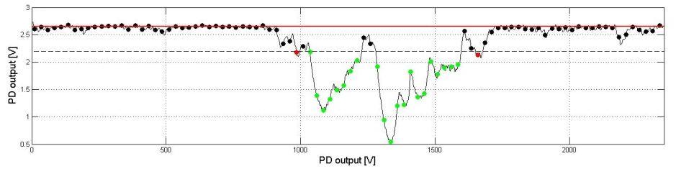
GRANDproto radio array
DAQ system (LPNHE design & proto)
  Trigger on 30-100MHz analog signal
  Enveloppe detection
  Front end digitization
  GPS timing
  100% duty cycle up to ~20kHz
Also 3 units equiped with AUGER-AERA DAQ (cross checks)
Simulated signal at filter output
Simulated signal at
power detector output
Simulated signal at
ADC output (50MS/s)

Slide 23
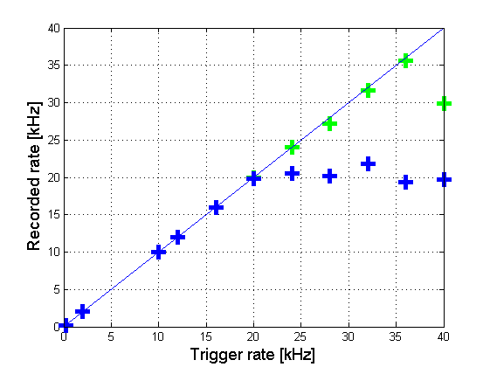
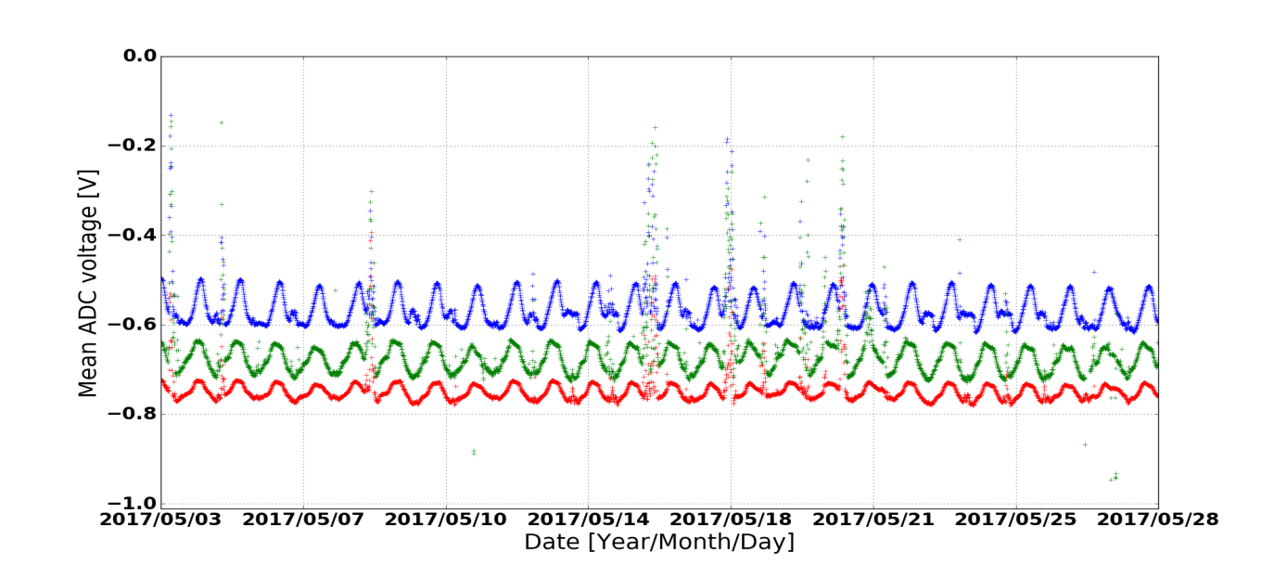
GRANDproto35 DAQ performances
Recorded trace duration = 3µs
Recorded trace duration = 1.5µs
100% DAQ live time up to extremely large trigger rates.
Stability checked over very long periods of times
X arm Y arm Z arm
26 days

Slide 24
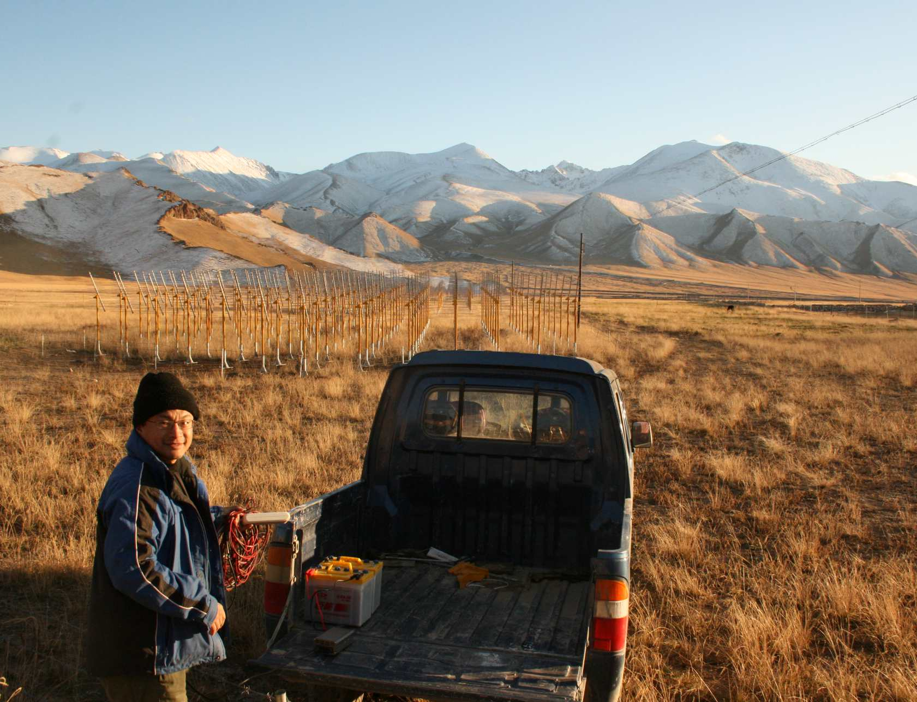
Conclusion
TREND accomplished its initial goal: performing succesfull detection & identification of air shower with an autonomous radio array. Paper in preparation. Many flows but seed for more ambitious radiodetection projects!
Next step: GRANDproto35 (larger efficiency & purity), starting very soon
Later on: GRAND [see C. Timmermans talk Saturday]
谢谢

Slide 26
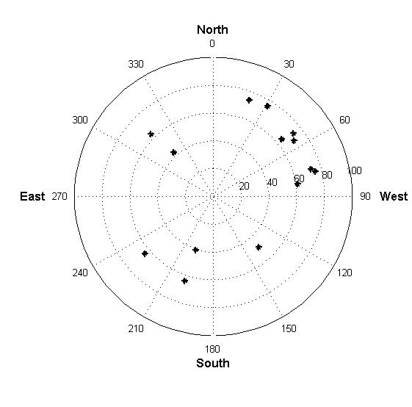
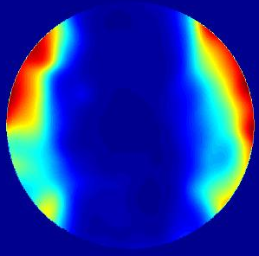
TREND EAS Candidates
2013 data
(NS polar, 125 DAQ days)
14 candidates
Very low stat BUT distribution differs significantly from EW polar, as expected for EAS.
Simulated skymap p@1 10¹⁷eV
90°
60°
30°
VERY PRELIMINARY

Slide 27
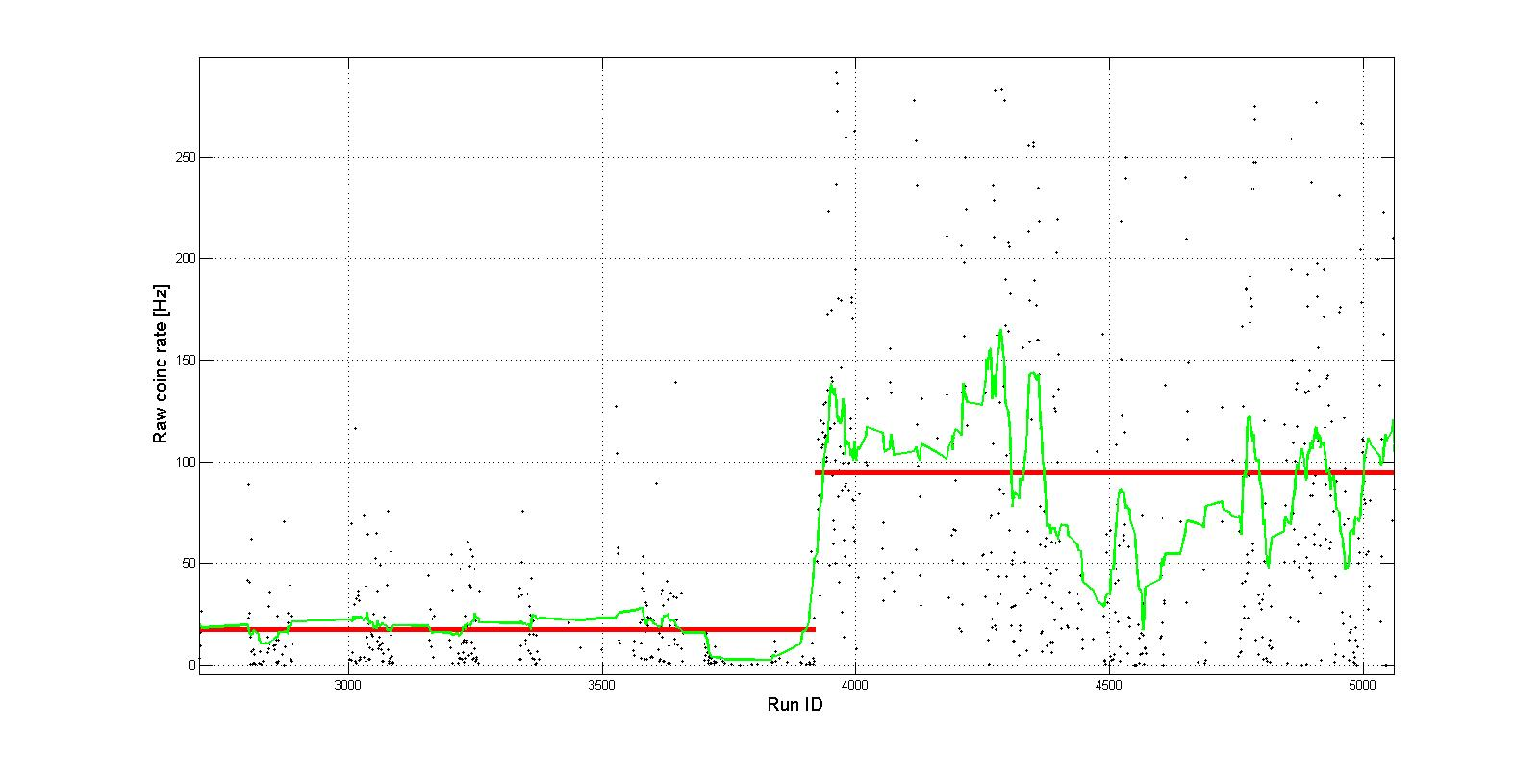
TREND-50 2013
Possible causes for much fewer candidates:
  Array maintenance degraded (>30% antennas off)
  Bckgd noise significantly higher, affects DAQ duty cycle & acceptance (environment cuts)
March 2011
Aug 2012
Dec 2012
June 2014
2011: 2012:
EW polar
2013-2014:
NS polar
<Coinc rate> ~100Hz
<Coinc rate> ~15Hz

Slide 28
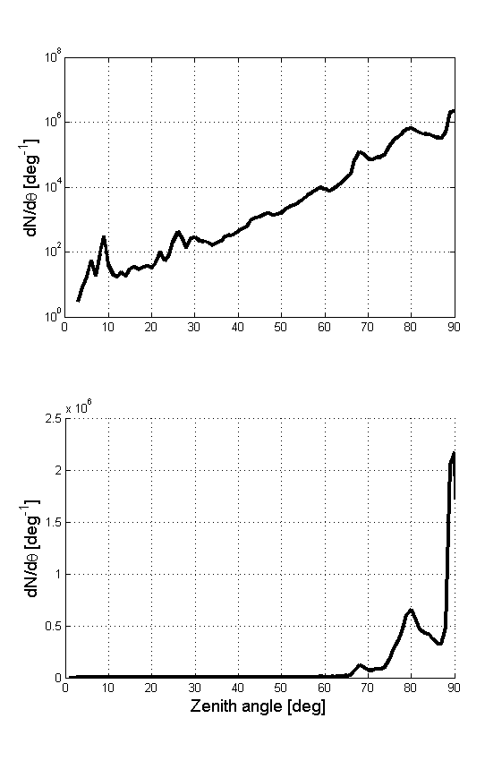
Radio background
Zenith distribution
Azimuth distribution
Log scale
Here selecting plane wavefronts only (curvature radius>500m)
Most events coming from specific directions (N,E,W) along horizon (static noise sources)
North
West
South
East
Lin scale

